Slide 1
TODO LIST APPLICATION
BY: Ritikaa Kailas

Slide 2
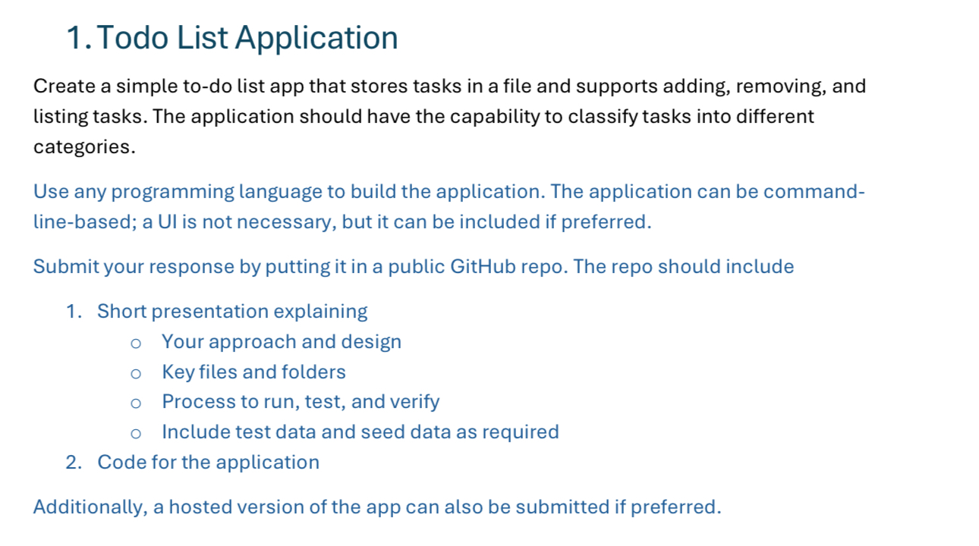
CHALLENGE AND MY APPROACH
Deliverables:
🏗️ Clean Architecture - Built for maintainability
🎨 Rich User Experience - Professional CLI interface
📊 Advanced Features - Beyond basic CRUD operations
📝 Production Ready - Comprehensive documentation

Slide 3
SYSTEM ARCHITECTURE
MVC ARCHITECTURE - Separation of model(Task), View(CLI), and controller(TaskService)
👤 USER INTERFACE - (User Input/Display)
🎮 TodoApp.java - CLI Controller - (Commands)
🧠 TaskService.java - Business Logic - (CRUD Operations)
💾 FileRepository.java - Data Layer - (JSON Serialization)
📄 tasks.json - File Storage
WHY THIS ARCHITECTURE?
Single Responsibility: Each class has one job
Loose Coupling: Easy to swap components
Testable: Can test each layer independently
Scalable: Add web UI without changing business logic

Slide 4
APPLICATION FEATURES
CORE FUNCTIONALITY
Smart task creation - Add tasks with intelligent validation
Safe task management - Removes tasks with confirmation prompts
Rich task display - Table format with emojis
Category organization - Filter and organize tasks by categories
Auto-save storage - Persistent JSON file storage with error handling

Slide 5
ADVANCED FEATURES:
Intelligent search - Find tasks by partial title matching
Priority system - Three priority leves (HIGH, MEDIUM, LOW)
Due date management - Track deadlines
Progress statistics - Real-time completion rates and task analytics
Professional Interface - clean tables and visual indicators
Robust error Handling - Failure recovery and user feedback

Slide 6
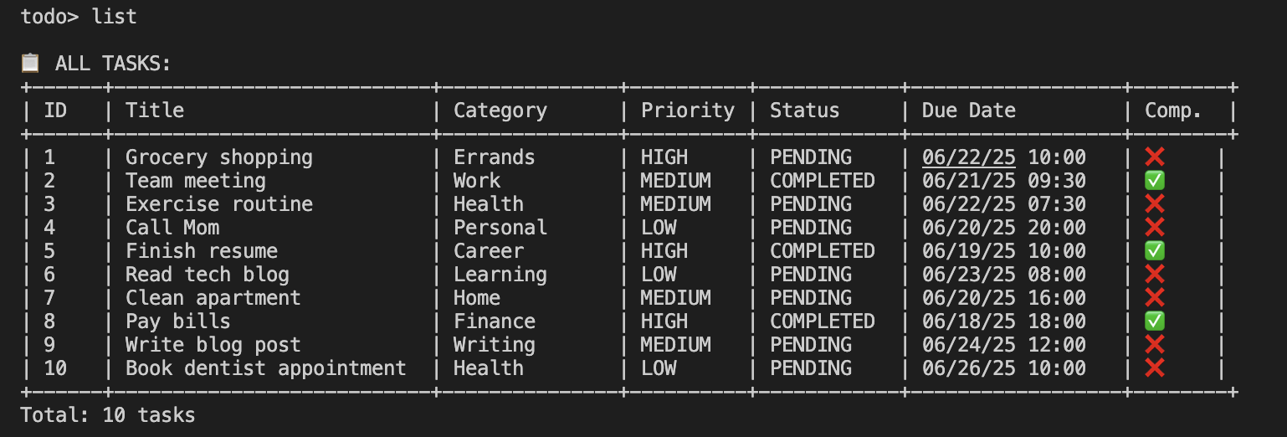
USER EXPERIENCE DESIGN
TABLE DISPLAY

Slide 7
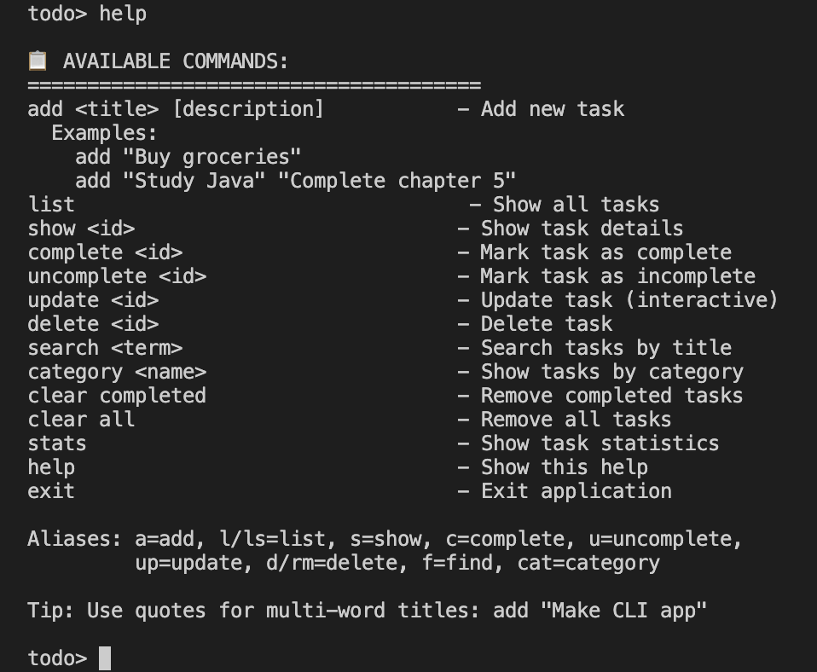
Commands

Slide 8
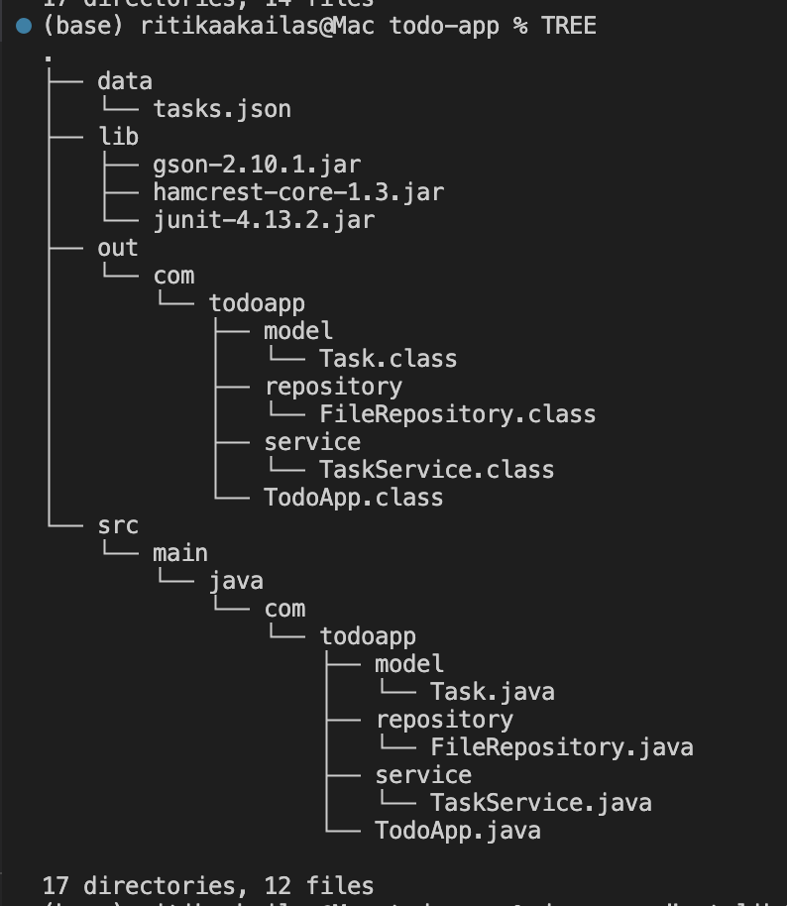
PROJECT STRUCTURE
KEY POINTS
Standard JAVA package structure
Clear separation of concerns
Easy to navigate and understand
Ready for IDE import

Slide 9
SCALABILITY AND FUTURE SCOPE
THIS ARCHITECTURE ENABLES:
🌐 WEB APPLICATION - Same backend, add Spring Boot Rest API
📱 MOBILE APP - JSON API already ready for consumption
🗄️ DATABASE INTEGRATION - Swap FileRepository for JPA/Hibernate
👥 MULTI-USER SUPPORT - Add authentication layer
🔔 NOTIFICATIONS - Plugin architecture supports extensions
📊 ANALYTICS DASHBOARD - Data layer abstracted and queryable

Slide 10
CODE WALKTHROUGH

Slide 11
THANK YOU

